Slide 1
LOWER SIXTH ARTS
GEOGRAPHY
Lesson 8
Agricultural Development and Change in Cameroon
Notes:
Good morning, class, and welcome to our geography lesson. I am your geography teacher, Mr Kamdem. Today we are starting Lesson 8: Agricultural Development and Change in Cameroon.

Slide 2
CLASS INFO
Class, Chapter and Duration
Class | Lower Sixth Arts
Chapter | Geography of Cameroon
Duration | 2 periods (2 × 50 minutes)
Notes:
This lesson is for Lower Sixth Arts. It belongs to Geography of Cameroon. We shall need 2 periods to cover it.

Slide 3
IDENTIFICATION
Lesson Identification
Topic | Geography of Cameroon
Sub-topic | Population, Settlement and Resources of Cameroon
Lesson | Lesson 8: Agricultural Development and Change in Cameroon
Notions / Concepts | Agriculture, peasant farming, plantation, livestock farming, intensive, extensive, yield, second-generation agriculture.
Syllabus focus | General characteristics, types, productivity and importance of agriculture; systems (peasant crop production, modern plantations, traditional and modern livestock farming) and their spatial distribution; factors; impacts; problems and solutions; changes since independence.
Competence | Learners are able to describe the agricultural systems of Cameroon, explain their distribution and propose solutions to agricultural problems.
Notes:
Our topic is Geography of Cameroon, and the sub-topic is Population, Settlement and Resources of Cameroon. The key notions we shall use today are: agriculture, peasant farming, plantation, livestock farming, intensive, extensive, yield, second-generation agriculture. At the end, you should be able to do this: learners are able to describe the agricultural systems of Cameroon, explain their distribution and propose solutions to agricultural problems.

Slide 4

HOMEWORK CORRECTION
Correction of the Homework
Question (Lesson 7: Urbanisation in Cameroon):
Name two agro-industrial companies of Cameroon.
Notes:
Before we start the new lesson, let us correct the homework I gave you at the end of Lesson 7: Urbanisation in Cameroon. The question was: Name two agro-industrial companies of Cameroon. Take out your exercise books.

Slide 5
HOMEWORK CORRECTION
Correction: Possible Answer
SODECOTON (cotton) and the CDC (bananas, rubber, oil palm); also SEMRY (rice) and PAMOL (oil palm).
Notes:
Here is a good answer. SODECOTON (cotton) and the CDC (bananas, rubber, oil palm); also SEMRY (rice) and PAMOL (oil palm). Compare it with your own answer and correct your work in red.

Slide 6
LESSON PLAN
Lesson Plan
Correction of the homework
Objectives and recall
Real-life situation and action to take
Learning activities
Board summary
Evaluation, remediation and homework
Notes:
Here is the plan of our lesson today. First, we shall correct the homework. Then we shall look at the objectives and recall what you already know. After that, we shall study a situation from real life and the action to take, and do the learning activities. Finally, we shall copy the board summary, do the evaluation and the remediation, and I will give you the homework.

Slide 7
OBJECTIVES
Objectives
By the end of this lesson, you should be able to:
Explain the characteristics and importance of agriculture in Cameroon.
Describe the agricultural systems and their distribution.
Notes:
Take your time to copy this part; we will continue together.

Slide 8
OBJECTIVES
Objectives (continued)
Explain the factors that influence agriculture.
Analyse the impacts and problems of agriculture and their solutions.
Describe the changes in agriculture since independence.
Notes:
By the end of this lesson, you should be able to do five things. Number 1: explain the characteristics and importance of agriculture in Cameroon. Number 2: describe the agricultural systems and their distribution. Number 3: explain the factors that influence agriculture. Number 4: analyse the impacts and problems of agriculture and their solutions. Number 5: describe the changes in agriculture since independence.

Slide 9
PREVIOUS KNOWLEDGE
Previous Knowledge
Most people in rural areas are farmers.
Cotton is the main cash crop of the North.
SODECOTON buys cotton from farmers.
Notes:
Let us first remember what you already know. Most people in rural areas are farmers. Cotton is the main cash crop of the North. SODECOTON buys cotton from farmers. Keep this in mind, because we shall build on it today.

Slide 10
REAL-LIFE SITUATION
Situation in Real Life
Near Garoua, old Mallam Issa grows millet and sorghum on a small plot with a hoe and his family's help, mostly to feed his family.
Notes:
Take your time to copy this part; we will continue together.

Slide 11
REAL-LIFE SITUATION
Situation in Real Life (continued)
His neighbour's son Abdou works for SODECOTON, where cotton is grown with selected seeds, fertilisers and tractors and sold for export.
"
Notes:
Listen carefully to this situation from real life. Near Garoua, old Mallam Issa grows millet and sorghum on a small plot with a hoe and his family's help, mostly to feed his family. His neighbour's son Abdou works for SODECOTON, where cotton is grown with selected seeds, fertilisers and tractors and sold for export. Abdou asks: "Why are there such different ways of farming in Cameroon, and how can our agriculture improve?" Think about it, because I am going to ask you some questions.

Slide 12
REAL-LIFE SITUATION
Situation: Question 1
What is the problem in the situation?
Notes:
Question 1: What is the problem in the situation? Think for a moment, then raise your hand to answer.

Slide 13
REAL-LIFE SITUATION
Answer
Abdou wants to understand the different farming systems and how agriculture can improve.
Notes:
Good. Abdou wants to understand the different farming systems and how agriculture can improve.

Slide 14
REAL-LIFE SITUATION
Situation: Question 2
What does Mallam Issa grow and why?
Notes:
Question 2: What does Mallam Issa grow and why? Think for a moment, then raise your hand to answer.

Slide 15
REAL-LIFE SITUATION
Answer
Millet and sorghum, mainly to feed his family.
Notes:
Good. Millet and sorghum, mainly to feed his family.

Slide 16
REAL-LIFE SITUATION
Situation: Question 3
What does SODECOTON produce?
Notes:
Question 3: What does SODECOTON produce? Think for a moment, then raise your hand to answer.

Slide 17
REAL-LIFE SITUATION
Possible Answer
Cotton for sale and export.
Notes:
Good. Cotton for sale and export.

Slide 18
ACTION TO TAKE
Action to Take
Support modern, sustainable farming and protect farmland from erosion.
Notes:
From this situation, the action we are working towards in this lesson is the following: support modern, sustainable farming and protect farmland from erosion.

Slide 19
JUSTIFICATION
Justification of the Lesson
This lesson helps us to understand agriculture, the main activity of Cameroonians, and the changes needed to feed the nation.
Notes:
Why is this lesson important for you? This lesson helps us to understand agriculture, the main activity of Cameroonians, and the changes needed to feed the nation.

Slide 20
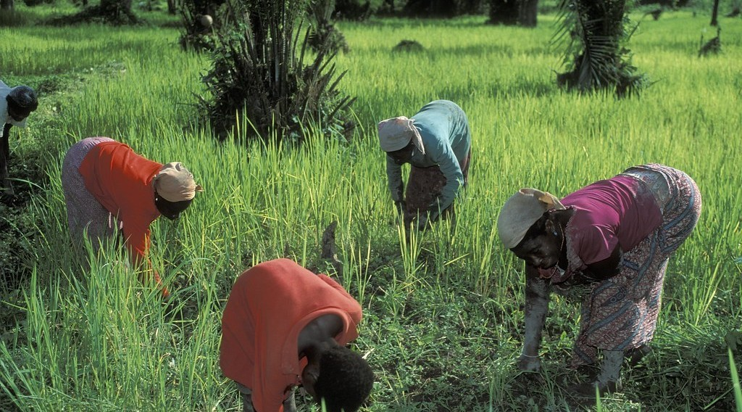
1. GENERAL CHARACTERISTICS
Activity 1
Women working on a farm.
Notes:
Activity 1. Look carefully at this picture: women working on a farm. Observe every detail before I ask the question.

Slide 21
1. GENERAL CHARACTERISTICS
Activity 1: Question
Which tools do most peasant farmers use?
Notes:
Here is the question for Activity 1: Which tools do most peasant farmers use? Take one minute to think and write your answer in your rough notebook.

Slide 22
1. GENERAL CHARACTERISTICS
Activity 1: Answer
Simple tools such as hoes and cutlasses.
Notes:
Let us check the answer together. Simple tools such as hoes and cutlasses.

Slide 23
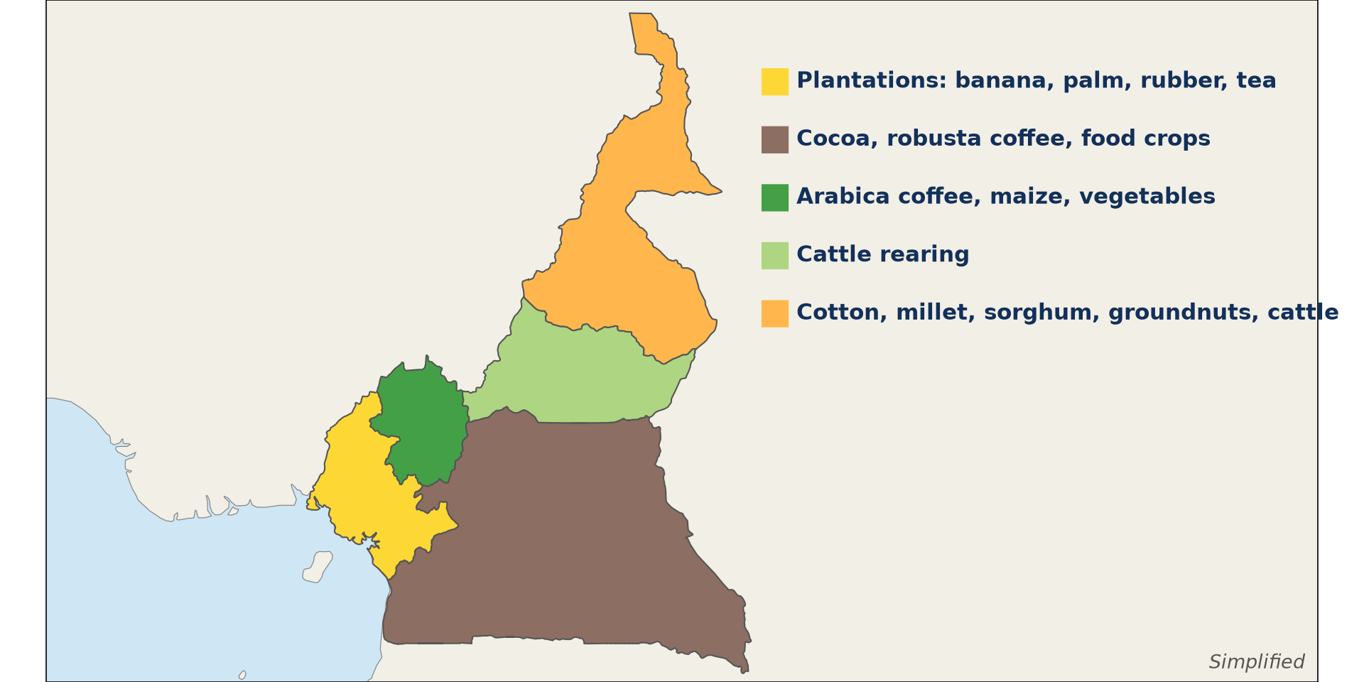
2. AGRICULTURAL SYSTEMS
Activity 2
Agricultural regions of Cameroon.
Notes:
Activity 2. Look carefully at this diagram: agricultural regions of Cameroon. Observe every detail before I ask the question.

Slide 24
2. AGRICULTURAL SYSTEMS
Activity 2: Question
Which crops dominate the north of Cameroon?
Notes:
Here is the question for Activity 2: Which crops dominate the north of Cameroon? Take one minute to think and write your answer in your rough notebook.

Slide 25
2. AGRICULTURAL SYSTEMS
Activity 2: Answer
Cotton, millet, sorghum and groundnuts, with cattle rearing.
Notes:
Let us check the answer together. Cotton, millet, sorghum and groundnuts, with cattle rearing.

Slide 26

2. AGRICULTURAL SYSTEMS
Activity 3
An oil palm plantation.
Notes:
Activity 3. Look carefully at this picture: an oil palm plantation. Observe every detail before I ask the question.

Slide 27
2. AGRICULTURAL SYSTEMS
Activity 3: Question
What is special about a plantation?
Notes:
Here is the question for Activity 3: What is special about a plantation? Take one minute to think and write your answer in your rough notebook.

Slide 28
2. AGRICULTURAL SYSTEMS
Activity 3: Answer
It is a very large farm growing one cash crop for sale, with hired workers and much capital.
Notes:
Let us check the answer together. It is a very large farm growing one cash crop for sale, with hired workers and much capital.

Slide 29

2. AGRICULTURAL SYSTEMS
Activity 4
Herders with cattle.
Notes:
Activity 4. Look carefully at this picture: herders with cattle. Observe every detail before I ask the question.

Slide 30
2. AGRICULTURAL SYSTEMS
Activity 4: Question
Why do Mbororo herders move with their cattle in the dry season?
Notes:
Here is the question for Activity 4: Why do Mbororo herders move with their cattle in the dry season? Take one minute to think and write your answer in your rough notebook.

Slide 31
2. AGRICULTURAL SYSTEMS
Activity 4: Answer
To find grass and water (transhumance).
Notes:
Let us check the answer together. To find grass and water (transhumance).

Slide 32

5. CHANGES SINCE INDEPENDENCE
Activity 5
A research field.
Notes:
Activity 5. Look carefully at this picture: a research field. Observe every detail before I ask the question.

Slide 33
5. CHANGES SINCE INDEPENDENCE
Activity 5: Question
How does IRAD help farmers?
Notes:
Here is the question for Activity 5: How does IRAD help farmers? Take one minute to think and write your answer in your rough notebook.

Slide 34
5. CHANGES SINCE INDEPENDENCE
Activity 5: Answer
It creates improved seeds and teaches better methods.
Notes:
Let us check the answer together. It creates improved seeds and teaches better methods.

Slide 35
BOARD SUMMARY
Board Summary
Topic: Geography of Cameroon
Sub-topic: Population, Settlement and Resources of Cameroon
Lesson 8: Agricultural Development and Change in Cameroon
Notes:
Now we are going to copy the board summary. Write the title and the headings neatly in your notebooks. I will give you enough time for each slide, so do not rush.

Slide 36
BOARD SUMMARY
DEFINITIONS
The key terms of this lesson are defined as follows:
Agriculture: It is the growing of crops and the rearing of animals for food, income and raw materials.
Peasant farming: It is small-scale farming by families, mainly for their own food.
Notes:
Let us copy the definitions. The key terms of this lesson are defined as follows. On this slide we have Agriculture and Peasant farming. Write each point on a new line, with the key term first, and explain it in your own words when we revise. When you finish, we go to the next slide.

Slide 37
BOARD SUMMARY
DEFINITIONS (continued)
Plantation: It is a very large farm that specialises in one cash crop for sale, with much capital and hired labour.
Yield: It is the quantity produced per hectare or per animal.
Notes:
We continue with the definitions. On this slide we have Plantation and Yield. Write each point on a new line, with the key term first, and explain it in your own words when we revise.

Slide 38
BOARD SUMMARY
1. General Characteristics, Types, Productivity and Importance
The characteristics, types, productivity and importance of agriculture in Cameroon are the following:
Characteristics: It is dominated by small family farms using simple tools, rainfall and little capital, beside a few large plantations.
Illustration: peasant farming
Notes:
Let us copy General Characteristics, Types, Productivity and Importance. The characteristics, types, productivity and importance of agriculture in Cameroon are the following. Copy the point on Characteristics on the left, then draw the diagram on the right: peasant farming. Give it a title and label it clearly.

Slide 39
BOARD SUMMARY
1. General Characteristics, Types, Productivity and Importance
Types: Food crops (cassava, maize, plantain, sorghum), cash crops (cocoa, coffee, cotton, bananas, rubber, oil palm) and livestock (cattle, sheep, goats, poultry).
Productivity: Yields are generally low on peasant farms and high on plantations.
Notes:
We continue with General Characteristics, Types, Productivity and Importance. On this slide we have Types and Productivity. Write each point on a new line, with the key term first, and explain it in your own words when we revise. When you finish, we go to the next slide.

Slide 40
BOARD SUMMARY
1. General Characteristics, Types, Productivity and Importance (continued)
Importance: It employs over 40 % of workers (most rural people), provides food, supplies raw materials to industries and earns export revenue; Cameroon is one of the world's leading cocoa producers.
Notes:
We continue with General Characteristics, Types, Productivity and Importance. On this slide we have Importance. Write each point on a new line, with the key term first, and explain it in your own words when we revise.

Slide 41
BOARD SUMMARY
2. Agricultural Systems and Their Distribution
A) Crop Production by Peasants
Peasant crop production has the following characteristics:
Farm size and ownership: Small plots (often under 2 ha) owned by families or held under customary law.
Illustration: agricultural regions of Cameroon
Notes:
Let us copy Crop Production by Peasants. Peasant crop production has the following characteristics. Copy the point on Farm size and ownership on the left, then draw the diagram on the right: agricultural regions of Cameroon. Give it a title and label it clearly.

Slide 42
BOARD SUMMARY
2. Agricultural Systems and Their Distribution
A) Crop Production by Peasants
Labour and capital: Family labour, hoes and cutlasses, little money.
Methods: Shifting cultivation and bush fallowing in the forest, permanent farming with manure in dense areas, terraces in the Mandara Mountains.
Notes:
We continue with Crop Production by Peasants. On this slide we have Labour and capital and Methods. Write each point on a new line, with the key term first, and explain it in your own words when we revise. When you finish, we go to the next slide.

Slide 43
BOARD SUMMARY
2. Agricultural Systems and Their Distribution
A) Crop Production by Peasants (continued)
Purpose and products: Mainly food for the family, with some cash crops: cocoa and coffee in the south and west, cotton in the north.
Notes:
We continue with Crop Production by Peasants. On this slide we have Purpose and products. Write each point on a new line, with the key term first, and explain it in your own words when we revise.

Slide 44
BOARD SUMMARY
2. Agricultural Systems and Their Distribution
B) Modern Plantation Systems
The characteristics and location of modern plantations are the following:
Farm size and ownership: Estates of hundreds or thousands of hectares owned by the state or companies (CDC, SOCAPALM, PAMOL, PHP, SOSUCAM).
Illustration: an oil palm plantation
Notes:
Let us copy Modern Plantation Systems. The characteristics and location of modern plantations are the following. Copy the point on Farm size and ownership on the left, then draw the diagram on the right: an oil palm plantation. Give it a title and label it clearly.

Slide 45
BOARD SUMMARY
2. Agricultural Systems and Their Distribution
B) Modern Plantation Systems
Labour and capital: Many paid workers, machines, fertilisers, pesticides and processing factories.
Location: Mainly in the fertile coastal lowlands (South-West, Littoral, Mungo) and near Mbandjock (sugar cane).
Notes:
We continue with Modern Plantation Systems. On this slide we have Labour and capital and Location. Write each point on a new line, with the key term first, and explain it in your own words when we revise. When you finish, we go to the next slide.

Slide 46
BOARD SUMMARY
2. Agricultural Systems and Their Distribution
B) Modern Plantation Systems (continued)
Purpose and products: Bananas, rubber, oil palm, tea and sugar cane, mainly for export and industry.
Notes:
We continue with Modern Plantation Systems. On this slide we have Purpose and products. Write each point on a new line, with the key term first, and explain it in your own words when we revise.

Slide 47
BOARD SUMMARY
2. Agricultural Systems and Their Distribution
C) Livestock Farming Systems
The traditional and modern livestock systems and their main areas are the following:
Traditional (extensive): Nomadism and transhumance by Mbororo and Fulani herders in the Adamawa, North, Far North and North-West, with large herds and little capital.
Illustration: herders and cattle
Notes:
Let us copy Livestock Farming Systems. The traditional and modern livestock systems and their main areas are the following. Copy the point on Traditional (extensive) on the left, then draw the diagram on the right: herders and cattle. Give it a title and label it clearly.

Slide 48
BOARD SUMMARY
2. Agricultural Systems and Their Distribution
C) Livestock Farming Systems
Modern (intensive): Ranches with fenced pastures and veterinary care, such as SODEPA ranches in the Adamawa, and modern poultry and pig farms near towns.
Notes:
We continue with Livestock Farming Systems. On this slide we have Modern (intensive). Write each point on a new line, with the key term first, and explain it in your own words when we revise. When you finish, we go to the next slide.

Slide 49
BOARD SUMMARY
2. Agricultural Systems and Their Distribution
C) Livestock Farming Systems (continued)
Main areas: The Adamawa Plateau is the main cattle region, free of tsetse flies at high altitude.
Notes:
We continue with Livestock Farming Systems. On this slide we have Main areas. Write each point on a new line, with the key term first, and explain it in your own words when we revise.

Slide 50
BOARD SUMMARY
3. Factors of Agricultural Systems
The characteristics and distribution of farming depend on the following factors:
Physical factors: Climate (cocoa in the wet south, cotton and sorghum in the dry north), soils (volcanic and black soils) and relief (terraces on slopes).
Notes:
Let us copy Factors of Agricultural Systems. The characteristics and distribution of farming depend on the following factors. On this slide we have Physical factors. Write each point on a new line, with the key term first, and explain it in your own words when we revise. When you finish, we go to the next slide.

Slide 51
BOARD SUMMARY
3. Factors of Agricultural Systems (continued)
Human factors: Population density, land tenure and farming traditions.
Economic inputs: Capital, credit, roads, markets, machines, fertilisers and research.
Cultural influences: Cattle are a sign of wealth among the Fulani, and some groups prefer certain crops.
Notes:
We continue with Factors of Agricultural Systems. On this slide we have Human factors, Economic inputs and Cultural influences. Write each point on a new line, with the key term first, and explain it in your own words when we revise.

Slide 52
BOARD SUMMARY
4. Impacts, Problems and Solutions
A) Impacts of Agriculture
Agriculture has the following impacts:
On the economy and communities: Employment, export revenue, food supply and better living standards for farmers.
Notes:
Let us copy Impacts of Agriculture. Agriculture has the following impacts. On this slide we have On the economy and communities. Write each point on a new line, with the key term first, and explain it in your own words when we revise. When you finish, we go to the next slide.

Slide 53
BOARD SUMMARY
4. Impacts, Problems and Solutions
A) Impacts of Agriculture (continued)
On the environment: Deforestation, soil erosion, bush fires, overgrazing and pollution by fertilisers and pesticides.
Notes:
We continue with Impacts of Agriculture. On this slide we have On the environment. Write each point on a new line, with the key term first, and explain it in your own words when we revise.

Slide 54
BOARD SUMMARY
4. Impacts, Problems and Solutions
B) Problems and Solutions
Agriculture faces the following problems and solutions:
Physical problems: Drought and irregular rain in the north, poor leached soils in the south, floods, pests (locusts, caterpillars) and diseases.
Notes:
Let us copy Problems and Solutions. Agriculture faces the following problems and solutions. On this slide we have Physical problems. Write each point on a new line, with the key term first, and explain it in your own words when we revise. When you finish, we go to the next slide.

Slide 55
BOARD SUMMARY
4. Impacts, Problems and Solutions
B) Problems and Solutions (continued)
Man-made problems: Land tenure disputes, small farms, simple techniques, bad roads, poor storage and low, unstable prices.
Notes:
We continue with Problems and Solutions. On this slide we have Man-made problems. Write each point on a new line, with the key term first, and explain it in your own words when we revise. When you finish, we go to the next slide.

Slide 56
BOARD SUMMARY
4. Impacts, Problems and Solutions
B) Problems and Solutions (continued)
Solutions: Irrigation, improved seeds, fertilisers, credit, farm roads, storage facilities, cooperatives and training by extension workers.
Notes:
We continue with Problems and Solutions. On this slide we have Solutions. Write each point on a new line, with the key term first, and explain it in your own words when we revise.

Slide 57
BOARD SUMMARY
5. Changes and Reforms since Independence
Agriculture has changed in the following ways:
State agro-industrial companies: SODECOTON (cotton), CDC (plantations), SEMRY (rice), UNVDA (rice at Ndop) and SODECAO (cocoa) organise production.
Notes:
Let us copy Changes and Reforms since Independence. Agriculture has changed in the following ways. On this slide we have State agro-industrial companies. Write each point on a new line, with the key term first, and explain it in your own words when we revise. When you finish, we go to the next slide.

Slide 58
BOARD SUMMARY
5. Changes and Reforms since Independence (continued)
Green Revolution (1970s): The state promoted intensification with improved seeds, fertilisers and credit.
Notes:
We continue with Changes and Reforms since Independence. On this slide we have Green Revolution (1970s). Write each point on a new line, with the key term first, and explain it in your own words when we revise.

Slide 59
BOARD SUMMARY
5. Changes and Reforms since Independence
Research: IRAD develops higher-yielding, disease-resistant varieties of maize, sorghum, cassava and cotton.
Illustration: a research field
Notes:
Copy the point on Research on the left, then draw the diagram on the right: a research field. Give it a title and label it clearly.

Slide 60
BOARD SUMMARY
5. Changes and Reforms since Independence
Liberalisation (1990s): The state withdrew from marketing, and farmers formed cooperatives and common initiative groups (CIGs).
Notes:
We continue with Changes and Reforms since Independence. On this slide we have Liberalisation (1990s). Write each point on a new line, with the key term first, and explain it in your own words when we revise. When you finish, we go to the next slide.

Slide 61
BOARD SUMMARY
5. Changes and Reforms since Independence (continued)
Second-generation agriculture: Since 2011 the state promotes modern, mechanised and commercial farming by young farmers and agro-industries.
Notes:
We continue with Changes and Reforms since Independence. On this slide we have Second-generation agriculture. Write each point on a new line, with the key term first, and explain it in your own words when we revise.

Slide 62
FORMATIVE EVALUATION
Evaluation 1
Give two differences between peasant farming and plantations.
Notes:
Now let us check what you have understood. Question 1: Give two differences between peasant farming and plantations. Answer in your exercise book.

Slide 63
FORMATIVE EVALUATION
Expected Answer
Peasant farms are small with family labour and produce mainly food; plantations are huge, use hired labour and capital and produce cash crops for sale.
Notes:
The expected answer is: peasant farms are small with family labour and produce mainly food; plantations are huge, use hired labour and capital and produce cash crops for sale. If you got it right, well done.

Slide 64
FORMATIVE EVALUATION
Evaluation 2
Give two problems of agriculture in the North and one solution.
Notes:
Now let us check what you have understood. Question 2: Give two problems of agriculture in the North and one solution. Answer in your exercise book.

Slide 65
FORMATIVE EVALUATION
Expected Answer
Drought and poor storage; irrigation (or improved storage).
Notes:
The expected answer is: drought and poor storage; irrigation (or improved storage). If you got it right, well done.

Slide 66
REMEDIATION
Remediation
Fill in the blanks:
The company that organises cotton farming is ______.
Moving herds seasonally in search of pasture is ______.
Notes:
Take your time to copy this part; we will continue together.

Slide 67
REMEDIATION
Remediation (continued)
The research institute that creates improved seeds is ______.
Notes:
For those who need more practice, fill in the blanks in your exercise book. The answers are: number 1, SODECOTON; number 2, transhumance; number 3, IRAD.

Slide 68
HOMEWORK
Homework
Name two valuable timber species of Cameroon.
Notes:
For your homework: Name two valuable timber species of Cameroon. We shall correct it at the beginning of our next lesson.

Slide 69
NEXT LESSON
Next Lesson
Our next lesson will be on:
Lesson 9: Management of Forest Resources in Cameroon
Notes:
Our next lesson will be on Lesson 9: Management of Forest Resources in Cameroon. Thank you for your attention, and see you next time.

Slide 70
BILINGUAL GAME
Bilingual Game (Jeu Bilingue)
English | Français
Agriculture | L'agriculture
Peasant farming | L'agriculture paysanne
Plantation | La plantation
Yield | Le rendement
Livestock | Le bétail
Irrigation | L'irrigation
Cooperative | La coopérative
Cash crop | La culture de rente
Notes:
Let us play the bilingual game. I say a word in English, and you give me the French word. Then we do the reverse.

Slide 71
LOGBOOK
Official Logbook (1/2)
Module / Topic | Geography of Cameroon
Lesson Title | Lesson 8: Agricultural Development and Change in Cameroon
Expected Learning Outcomes | Explain the characteristics and importance of agriculture in Cameroon. Describe the agricultural systems and their distribution. Explain the factors that influence agriculture. Analyse the impacts and problems of agriculture and their solutions. Describe the changes in agriculture since independence.
Competence | Learners are able to describe the agricultural systems of Cameroon, explain their distribution and propose solutions to agricultural problems.
Notes:
I record this information in the official logbook of the class after the lesson.

Slide 72
LOGBOOK
Official Logbook (2/2)
Matter Taught | DEFINITIONS; General Characteristics, Types, Productivity and Importance; Crop Production by Peasants; Modern Plantation Systems; Livestock Farming Systems; Factors of Agricultural Systems; Impacts of Agriculture; Problems and Solutions; Changes and Reforms since Independence.
Evaluation | Formative evaluation and remediation exercise.
Homework | Name two valuable timber species of Cameroon.
Enrolment / Present / Absent | ____ / ____ / ____
Achievement | To be completed after the lesson.
Notes:
I complete the second page of the logbook: the matter taught, the evaluation, the homework and the attendance.

Slide 73
TEACHER'S NOTE
Teacher's Note
Timing: Homework correction, plan, objectives 8 min | Recall, situation, action 10 min | 5 activities 30 min | Board summary (copying) 30 min | Evaluation, remediation 10 min | Homework, next lesson 5 min | Logbook 7 min
Without the projector (Activity 1): list farm tools.
Without the projector (Activity 2): shade farming regions.
Without the projector (Activity 3): name plantations.
Without the projector (Activity 4): describe transhumance.
Without the projector (Activity 5): name improved crops.
Notes:
This slide is for me, the teacher: it gives the timing of the lesson and what to do if the projector is not available.

Slide 74
REFERENCES
References
Geography Syllabus for Sixth Forms (Lower and Upper Sixth), MINESEC, 2019 — Geography of Cameroon.
Teacher's course notes: Mr KAMDEM E., Cameroon Geography (LSA and USA), GBHS Garoua, 2026.
BUCREP, 3rd General Census of Population and Housing (2005); United Nations, World Population Prospects (2024 revision).
Photo, Activity 1: “Women doing work on crops” by World Bank Photo Collection, CC BY-NC-ND 2.0, via Flickr (https://www.flickr.com/photos/10816734@N03/2073350635)
Photo, Activity 3: “Aerial view of oil palm plantation” by CIFOR, CC BY-NC-ND 2.0, via Flickr (https://www.flickr.com/photos/45423546@N07/38802487905)
Photo, Activity 4: “Young cattle herders in Sénégal (West Africa)” by gbaku, CC BY-SA 2.0, via Flickr (https://www.flickr.com/photos/72105154@N00/525185172)
Photo, Activity 5: “CIMMYT international wheat nurseries growing in Ecuador” by CIMMYT, CC BY-NC-SA 2.0, via Flickr (https://www.flickr.com/photos/44760652@N05/5958068839)
Notes:
Take your time to copy this part; we will continue together.

Slide 75
REFERENCES
References (continued)
Diagrams and animations: drawn for this lesson (Geography Department).
Notes:
These are the references and picture credits used to prepare this lesson.

